Slide 1
The SLoCaT Rio+20 Initiative on Sustainable Mobility Cornie Huizenga, Joint Convener SLoCaT Partnership
Transforming Transportation 2012
Washington DC , 26-27 January 2012

Slide 2
The SLoCaT Partnership
Improve the knowledge on sustainable, low carbon transport, help develop better policies and catalyze their implementation
65 Members: International Organizations – Government – Development Banks – NGOs – Private Sector - Academe
African Development Bank (AfDB) * Alliance to Save Energy* Asian Development Bank (ADB) * Corporación Andina de Fomento (CAF) *Believe Sustainability * Cambridge Systematics Inc * Center for Clean Air Policy (CCAP) * Centre for Environment Planning & Technology (CEPT), Ahmedabad * Center for Science and Environment (CSE) * Center for Sustainable Transport (CTS) Mexico * Center for Transportation and Logistics Studies (PUSTRAL), Gadjah Mada University * Civic Exchange (CE) * Clean Air Initiative for Asian Cities (CAI-Asia) Center * Clean Air Institute (CAI) * German Technical Cooperation (GIZ) * Ecofys* EMBARQ, The WRI Center for Sustainable Transport * Energy Research Center Netherlands (ECN) * European Bank for Reconstruction and Development (EBRD) * European Cyclists' Federation (ECF)* European Institute for Sustainable Transport (EURIST)* Fraunhofer- Institute for Systems and Innovation Research (ISI)* Global Environmental Facility (GEF) * Global Transport Knowledge Partnership (gTKP)* Global Urban Development* Green Mobility Brazil*HealthBridge* Hong Kong Shanghai Bank (HSBC) * Inter-American Development Bank (IDB) * Interface for Cycling Expertise (I-CE) * International Association for Public Transport (UITP * International Energy Agency (IEA) * International Transport Forum (ITF) * International Union for the Conservation of Nature (IUCN) * International Union of Railways (UIC) * Institute for Global Environmental Strategies (IGES) * The Institute for Transport Studies, University of Leeds, UK* Institute of Urban Transport India (IUTI)* Institute for Transport Policy Studies (ITPS) *Institute for Transport and Development Policy (ITDP) * Institute of Transport Studies (ITS), University of California, Davis * Korean Transport Institute (KOTI) * Ministry of Land Infrastructure Transport and Tourism, Japan *Mobility Magazine* National Center for Transportation Studies (NCTS), Philippines * Rockefeller Foundation * Society of Indian Automotive Manufacturers (SIAM) * Stockholm Environment Institute (SEI) * Tehran Urban and Suburban Railway operation Company (TUSROC) * The Energy and Resources Institute (TERI) * Transport and Environment (T+E) * Transport Research Laboratory (TRL) * United Nations Center for Regional Development (UNCRD) * United Nations Department for Economic and Social Affairs (UN-DESA) * United Nations Habitat (UN Habitat)* United Nations Environment Program (UNEP) * University College of London, Department of Civil, Environmental and Geomatic Engineering * University of Transport and Communication (UTCC) Hanoi * University of Twente/ITC (UT/ITC) * VEOLIA Transport * Victoria Transport Policy Institute (VTPI)* Volvo Research and Education Foundations (VREF)* World Streets * Wuppertal Institute* WWF International
www.slocat.net

Slide 3
Millenium Development Goals
Transport
Eradicate extreme poverty and hunger
Achieve Universal primary education
Promote gender equality and empower women
Reduce Child Mortality
Improve Maternal Health
Combat HIV/AIDS, Malaria and other dieseases
Ensure Environmental Sustainability
Develop a Global Partnership for Development

Slide 4
UNCED: United Nations Conference on Environment and Development
Rio de Janeiro, 1992
Agenda 21
Transport referenced in Agenda 21 but did not spark-off wide spread action on Sustainable Transport
WSSD: World Summit on Sustainable Development
Johannesburg, 2002
Johannesburg Plan of
Implementation
Transport referenced again, increased focus on sustainable transport since 2005/2006
UNCSD: United Nations Conference on Sustainable Development
Rio de Janeiro, 2012
Themes: Green Economy and Institutional Frameworks
Transport not one of 7 major themes, but we need Rio+20 for scaling up sustainable transport SDG on Transport

Slide 5
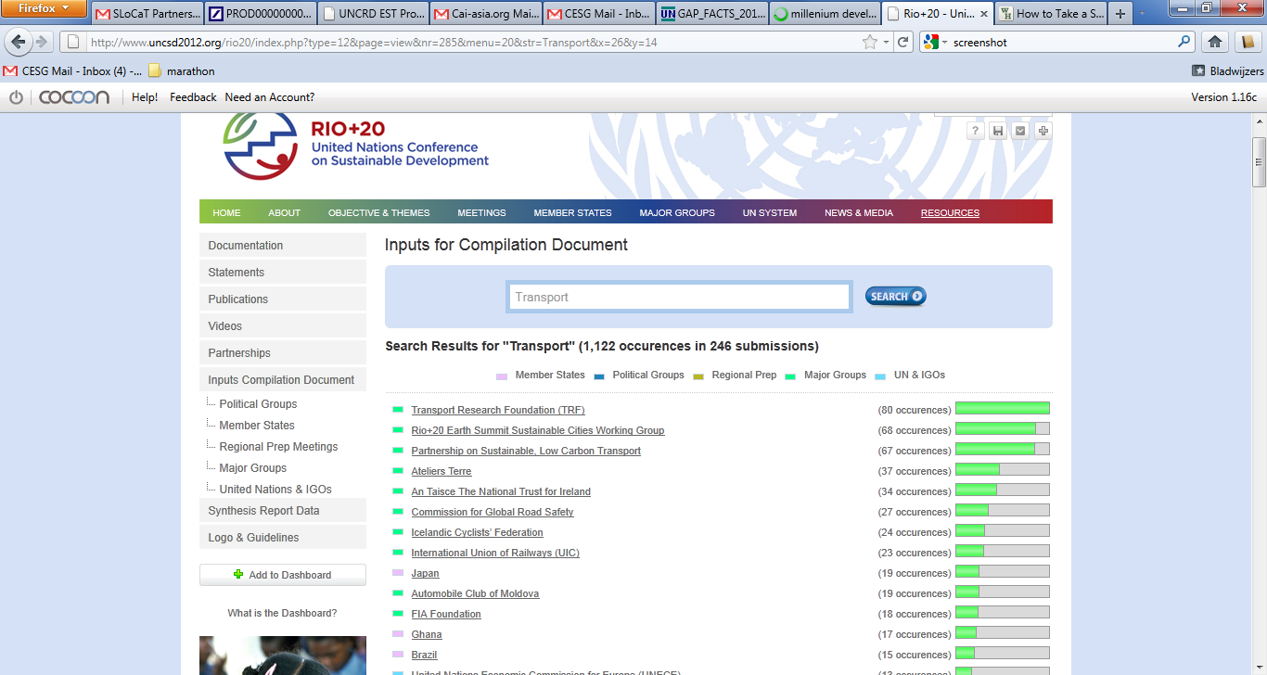
Compilation document
(647 submissions)
Transport Details Rio+20 Submissions
2nd. Intersessional
15-16/12/2011
Half of countries mention transport
Zero Draft outcome document January 2012
Sustainable Transport
Road safety special attention
3 rd. Intersessional
26-27/3/2011
Linkage with MDGs and Green Economy not well articulated
Informal negotiations
Passenger transport not freight
3rd. Prepcom
13-15/6/2012
Green Economy requires funding and capacity building assistance
Rio+20
20-22/06/2012

Slide 6
SLoCaT Submission to Rio+20
Adopt a Sustainable Development Goal specific to transportation:
Achieve sustainable transport that enables universal access to safe, clean, and affordable mobility.
1
Ensure global transport GHG emissions and transport sector fossil fuel consumption peak by 2020 and are cut by at least 40 % by 2050 compared to 2005 levels, while ensuring transport contributes to timely attainment of healthful air quality in all cities;
Support the Decade of Action for Road Safety (2011-20) and cut traffic-related deaths in half by 2025;
Ensure universal access to sustainable transport though support for safe, affordable public transport and safe, attractive facilities for walking and bicycling;
Strengthen institutional arrangements to advance sustainable transport.
2
Endorse + encourage voluntary country actions for sustainable transport.
3
Supported by: ADB, BtG, CTS-Mexico, CAF, CAI-Asia, ECN, ECF, EURIST, GIZ, GUD, IADB, ICE, IEA, ITDP, SEI, TRL, UITP, UT, Veolia-Transdev and ICCT

Slide 7
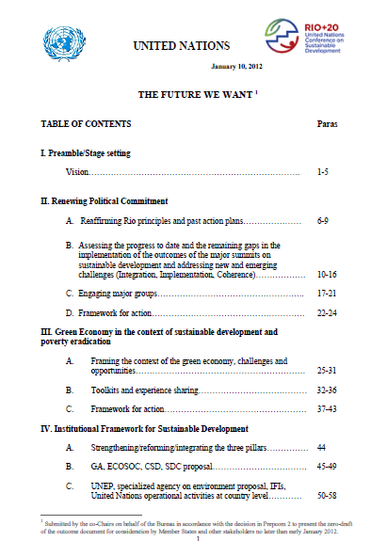
Zero Draft Outcome Document
Published January 10:
Transport mentioned 1 times
Energy mentioned 15 times
Sustainable Mobility as Priority Area under Green Economy
Sustainable mobility as possible SDG
Include sustainable mobility in Voluntary Commitments
Comments due from countries January 25 Section I+II
February 17 Section III-V
SLoCaT:
Letter to UNCSD Focal Points
Briefing UN Missions New York
Bilateral Meetings
Outreach meetings
Side event 3rd Intersessional

Slide 8
SLoCaT Rio+20 Proposed Initiative on Sustainable Transport in Developing Countries
Sustainable Development Goal on Sustainable Transport
“UN-Transport”
-Policy-
MDB Rio+20 initiative on Sustainable Transport
-Funding-

Slide 9
UN- Agencies
UN-DESA
Regional Commissions
UN Transport
SLoCaT
Strengthen coordination and coherence among UN agencies, including Regional Commissions on sustainable transport
UN Transport
“Light”
Or
UN Transport
“Medium”
Provide information, build knowledge
UN Secretary General High Level Council on Transport
Or
NGOs and Civil Society
Set global agenda on sustainable transport
UN Transport
“Heavy”
Private Sector
Conduct regional policy dialogs
EST
Resource mobilization
Development Banks and bilateral Development organizations

Slide 10
Name | Total Annual (2010) lending | Annual (2010) Transport lending
Multilateral Development Banks
African Development Bank | UA 4.1 billion (~$ 6.15 billion) | UA 1.2 billion (~$ 1.8 billion) transport
Asian Development Bank | $ 13.8 billion | ~$ 4.5-5 billion
European Bank for Reconstruction and Development | €9 billion total lending | € 1.5 billion transport,
European Investment Bank | € 5.5 billion | € 0.8 billion
Inter-American Development Bank | $ 12.1 billion total lending | $ 1.6 billion transport
Islamic Development Bank | $ 3.7 billion total lending | $ 1.0 billion transport
Latin American Development Bank (CAF) | $10.5 billion total lending | $ 4.3 billion transport
Development Bank for Southern Africa | Rand 17 billion (total lending) (~$ 2 billion) | ~$ 0.4 billion (estimate only)
World Bank | $ 43 billion | ~$ 8.6billion (2011)
Bilateral Development Banks
Agence France de Developpement | €6.8 billion | ~ € 1 billion transport
Japan International Cooperation Agency | $10.8 billion | ~$4.2 billion
Kreditanstallt fuer Wieder Aufbau | €4.4 billion | € 0.8 billion (estimate only)
Total Lending:
About $ 130-$ 150 billion per year
Transport lending:
About $ 30 billion per year
Suggested Rio+20 Pledge:
Mainstream Sustainability in continued Road lending
Re-orient lending portfolio towards sustainable transport
Leverage MDB transport funding (Sustainable Wealth Funds, Pension Funds)
MDB Group on Sustainable Transport

Slide 11
Proposed SLoCaT 2012 Activities in Support of Rio+20
Working Group to define Sustainable Transport/Mobility, set indicators and Targets (first half 2012)
Develop overall structure for Regional EST Forums in Asia, Africa, and Latin America (national +Cities), and develop proposals for active follow-up on Declarations (all of 2012)
Transport data – continue work on Global Transport Intelligence incorporating new IDB, ADB and WB data projects (all of 2012)
Urban Transport Finance – in support of EST Cities meetings in Asia and Latin America

Slide 12
SLoCaT at:
Visibility of Sustainable Mobility at Rio+20
Promote sustainable transport BEFORE Rio (website, newsletters, meetings)
“Package” all transport activities in Rio+20 and market these
Sustainable Mobility as 8th Round Table?
Integrate Transport in activities of other major groups: women, youth, private sector
Social Media

